Slide 1
JAVA BOOTCAMP DAY 13
Presented by
G2Academy

Slide 2
ERD
Notes:
How presentation will benefit audience: Adult learners are more interested in a subject if they know how or why it is important to them.
Presenter’s level of expertise in the subject: Briefly state your credentials in this area, or explain why participants should listen to you.

Slide 3
ER model
ER model stands for an Entity-Relationship model. It is a high-level data model. This model is used to define the data elements and relationship for a specified system.
It develops a conceptual design for the database. It also develops a very simple and easy to design view of data.
In ER modeling, the database structure is portrayed as a diagram called an entity-relationship diagram.
Notes:
Lesson descriptions should be brief.

Slide 4
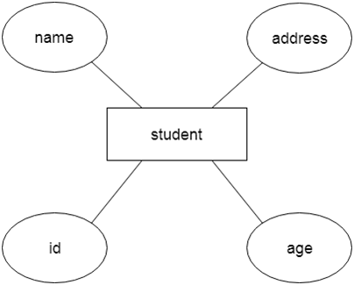
ER model
For example, Suppose we design a school database.
In this database, the student will be an entity with attributes like address, name, id, age, etc.
The address can be another entity with attributes like city, street name, pin code, etc and there will be a relationship between them.
Notes:
Lesson descriptions should be brief.

Slide 5
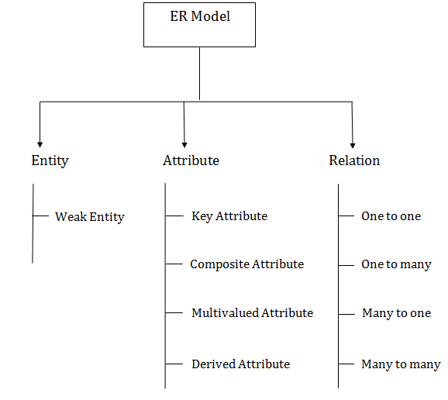
Component of ER Diagram
Notes:
Lesson descriptions should be brief.

Slide 6

Entity
An entity may be any object, class, person or place. In the ER diagram, an entity can be represented as rectangles.
Consider an organization as an example- manager, product, employee, department etc. can be taken as an entity.
Notes:
Lesson descriptions should be brief.

Slide 7

Entity
Weak Entity
An entity that depends on another entity called a weak entity.
The weak entity doesn't contain any key attribute of its own. The weak entity is represented by a double rectangle.
Notes:
Lesson descriptions should be brief.

Slide 8
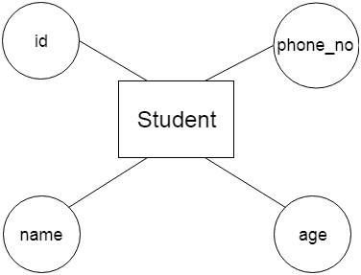
Attribute
The attribute is used to describe the property of an entity.
Eclipse is used to represent an attribute.
For example, id, age, contact number, name, etc. can be attributes of a student.
Notes:
Lesson descriptions should be brief.

Slide 9
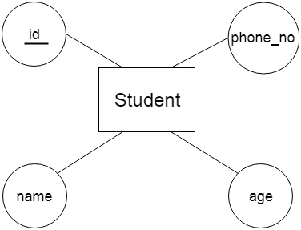
Attribute
Key Attribute
The key attribute is used to represent the main characteristics of an entity.
It represents a primary key.
The key attribute is represented by an ellipse with the text underlined.
Notes:
Lesson descriptions should be brief.

Slide 10
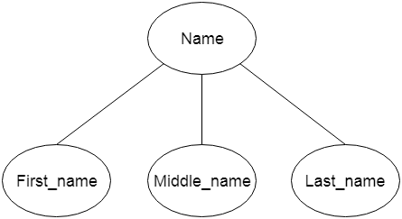
Attribute
Composite Attribute
An attribute that composed of many other attributes is known as a composite attribute.
The composite attribute is represented by an ellipse, and those ellipses are connected with an ellipse.
Notes:
Lesson descriptions should be brief.

Slide 11
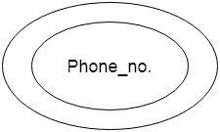
Attribute
Multivalued Attribute
An attribute can have more than one value.
These attributes are known as a multivalued attribute.
The double oval is used to represent multivalued attribute.
For example, a student can have more than one phone number.
Notes:
Lesson descriptions should be brief.

Slide 12
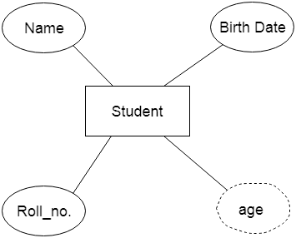
Attribute
Derived Attribute
An attribute that can be derived from other attribute is known as a derived attribute.
It can be represented by a dashed ellipse.
For example, A person's age changes over time and can be derived from another attribute like Date of birth.
Notes:
Lesson descriptions should be brief.

Slide 13

Relationship
A relationship is used to describe the relation between entities.
Diamond or rhombus is used to represent the relationship.
Notes:
Lesson descriptions should be brief.

Slide 14

Relationship
One-to-One Relationship
When only one instance of an entity is associated with the relationship, then it is known as one to one relationship.
For example, A female can marry to one male, and a male can marry to one female.
Notes:
Lesson descriptions should be brief.

Slide 15

Relationship
One-to-many relationship
When only one instance of the entity on the left, and more than one instance of an entity on the right associates with the relationship then this is known as a one-to-many relationship.
For example, Scientist can invent many inventions, but the invention is done by the only specific scientist.
Notes:
Lesson descriptions should be brief.

Slide 16

Relationship
Many-to-one relationship
When more than one instance of the entity on the left, and only one instance of an entity on the right associates with the relationship then it is known as a many-to-one relationship.
For example, Student enrolls for only one course, but a course can have many students.
Notes:
Lesson descriptions should be brief.

Slide 17

Relationship
Many-to-many relationship
When more than one instance of the entity on the left, and more than one instance of an entity on the right associates with the relationship then it is known as a many-to-many relationship.
For example, Employee can assign by many projects and project can have many employees.
Notes:
Lesson descriptions should be brief.

Slide 18
Manipulating Database with JDBC
Notes:
How presentation will benefit audience: Adult learners are more interested in a subject if they know how or why it is important to them.
Presenter’s level of expertise in the subject: Briefly state your credentials in this area, or explain why participants should listen to you.

Slide 19
Java JDBC
Java JDBC is a java API to connect and execute query with the database. JDBC API uses jdbc drivers to connect with the database.
Notes:
Lesson descriptions should be brief.

Slide 20
Why use JDBC
Before JDBC, ODBC API was the database API to connect and execute query with the database.
But, ODBC API uses ODBC driver which is written in C language (i.e. platform dependent and unsecured).
That is why Java has defined its own API (JDBC API) that uses JDBC drivers (written in Java language).
Notes:
Lesson descriptions should be brief.

Slide 21
What is API
API (Application programming interface) is a document that contains description of all the features of a product or software.
It represents classes and interfaces that software programs can follow to communicate with each other.
An API can be created for applications, libraries, operating systems, etc
Notes:
Lesson descriptions should be brief.

Slide 22
JDBC Driver
JDBC Driver is a software component that enables java application to interact with the database. There are 4 types of JDBC drivers:
JDBC-ODBC bridge driver
Native-API driver (partially java driver)
Network Protocol driver (fully java driver)
Thin driver (fully java driver)
Notes:
Lesson descriptions should be brief.

Slide 23
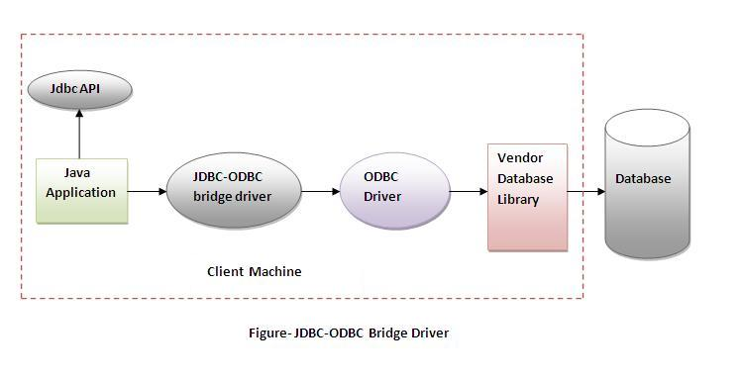
JDBC-ODBC bridge driver
The JDBC-ODBC bridge driver uses ODBC driver to connect to the database.
The JDBC-ODBC bridge driver converts JDBC method calls into the ODBC function calls.
This is now discouraged because of thin driver.
Notes:
Lesson descriptions should be brief.

Slide 24
JDBC-ODBC bridge driver
Advantages:
easy to use.
can be easily connected to any database.
Disadvantages:
Performance degraded because JDBC method call is converted into the ODBC function calls.
The ODBC driver needs to be installed on the client machine.
Notes:
Lesson descriptions should be brief.

Slide 25
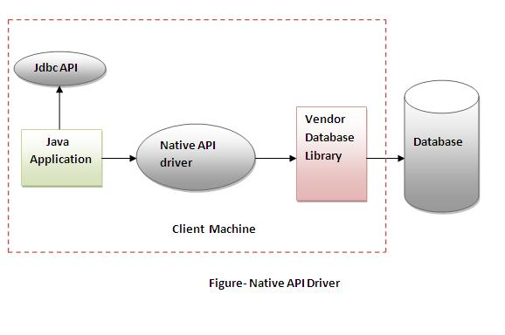
Native-API driver
The Native API driver uses the client-side libraries of the database.
The driver converts JDBC method calls into native calls of the database API.
It is not written entirely in java.
Notes:
Lesson descriptions should be brief.

Slide 26
Native-API driver
Advantages:
Performance upgraded than JDBC-ODBC bridge driver.
Disadvantages:
The Native driver needs to be installed on the each client machine.
The Vendor client library needs to be installed on client machine.
Notes:
Lesson descriptions should be brief.

Slide 27
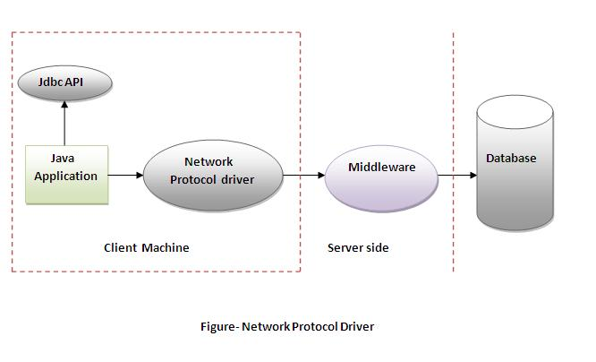
Network Protocol driver
The Network Protocol driver uses middleware (application server) that converts JDBC calls directly or indirectly into the vendor-specific database protocol.
It is fully written in java.
Notes:
Lesson descriptions should be brief.

Slide 28
Network Protocol driver
Advantages:
No client side library is required because of application server that can perform many tasks like auditing, load balancing, logging etc.
Disadvantages:
Network support is required on client machine.
Requires database-specific coding to be done in the middle tier.
Maintenance of Network Protocol driver becomes costly because it requires database-specific coding to be done in the middle tier.
Notes:
Lesson descriptions should be brief.

Slide 29
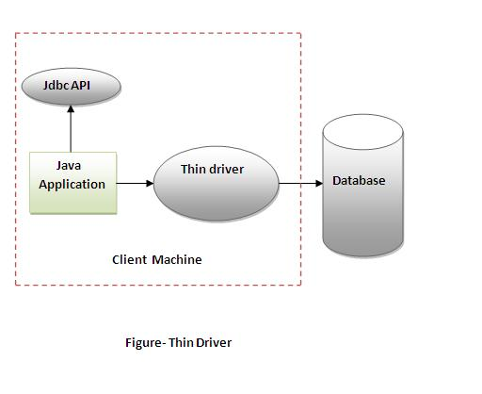
Thin driver
The thin driver converts JDBC calls directly into the vendor-specific database protocol. That is why it is known as thin driver.
It is fully written in Java language.
Notes:
Lesson descriptions should be brief.

Slide 30
Network Protocol driver
Advantages:
Better performance than all other drivers.
No software is required at client side or server side.
Disadvantages:
Drivers depends on the Database.
Notes:
Lesson descriptions should be brief.

Slide 31
5 Steps to connect to the database in java
There are 5 steps to connect any java application with the database in java using JDBC. They are as follows:
Register the driver class
Creating connection
Creating statement
Executing queries
Closing connection
Notes:
Lesson descriptions should be brief.

Slide 32
1. Register the driver class
The forName() method of Class class is used to register the driver class. This method is used to dynamically load the driver class.
Syntax of forName() method
public static void forName(String className)throws ClassNotFoundException
Example to register the OracleDriver class
Class.forName("oracle.jdbc.driver.OracleDriver");
Notes:
Lesson descriptions should be brief.

Slide 33
2. Create the connection object
The getConnection() method of DriverManager class is used to establish connection with the database.
Syntax of getConnection() method
public static Connection getConnection(String url)throws SQLException
public static Connection getConnection(String url,String name,String password)
throws SQLException
Example to establish connection with the Oracle database
Connection con=
DriverManager.getConnection( "jdbc:oracle:thin:@localhost:1521:xe","system","password");
Notes:
Lesson descriptions should be brief.

Slide 34
3. Create the Statement object
The createStatement() method of Connection interface is used to create statement.
The object of statement is responsible to execute queries with the database.
Syntax of createStatement() method
public Statement createStatement()throws SQLException
Example to create the statement object
Statement stmt=con.createStatement();
Notes:
Lesson descriptions should be brief.

Slide 35
4. Execute the query
The executeQuery() method of Statement interface is used to execute queries to the database.
This method returns the object of ResultSet that can be used to get all the records of a table.
Syntax of executeQuery() method
public ResultSet executeQuery(String sql)throws SQLException
Example to create the statement object
ResultSet rs=stmt.executeQuery("select * from emp");
while(rs.next()){
System.out.println(rs.getInt(1)+" "+rs.getString(2));
}
Notes:
Lesson descriptions should be brief.

Slide 36
5. Close the connection object
By closing connection object statement and ResultSet will be closed automatically.
The close() method of Connection interface is used to close the connection.
Syntax of close() method
public void close()throws SQLException
Example to close connection
con.close();
Notes:
Lesson descriptions should be brief.

Slide 37
Connect to the mysql database in java
For connecting java application with the mysql database, you need to follow steps to perform database connectivity.
In this example we are using MySql as the database. So we need to know following informations for the mysql database:
Driver class: The driver class for the mysql database is com.mysql.jdbc.Driver.
Notes:
Lesson descriptions should be brief.

Slide 38
Connect to the mysql database in java
Connection URL: The connection URL for the mysql database is jdbc:mysql://localhost:3306/sonoo where jdbc is the API, mysql is the database, localhost is the server name on which mysql is running, we may also use IP address, 3306 is the port number and sonoo is the database name. We may use any database, in such case, you need to replace the sonoo with your database name.
Username: The default username for the mysql database is root.
Password: Password is given by the user at the time of installing the mysql database. In this example, we are going to use root as the password.
Notes:
Lesson descriptions should be brief.

Slide 39
Installing MySQL
Get it from here: http://dev.mysql.com/downloads/mysql/5.5.html (Don't be fooled! You don't need to create an account. Follow the link "No thanks! Just take me to the downloads.") Grab the installer — it's much smaller than the zip archive. You can use either the 32 or 64-bit version.
Notes:
Lesson descriptions should be brief.

Slide 40
Installing MySQL
Proceed through the wizard, selecting a 'Typical' installation. You will see a 'MySQL Enterprise' popup at some point. Dismiss it.
Once the wizard has finished, the MySQL Server Instance Configuration Wizard starts.
Select 'Detailed Configuration'.
Select 'Developer Machine'.
Select 'Multifunctional database'.
Select a drive.
Notes:
Lesson descriptions should be brief.

Slide 41
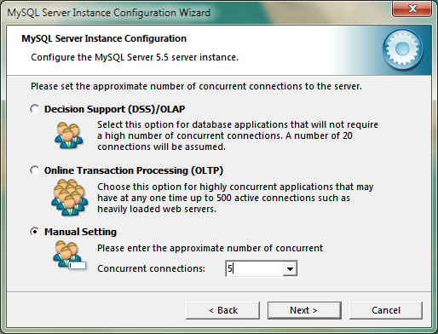
Installing MySQL
Select 'Manual setting', then enter a small number of concurrent connections.
Notes:
Lesson descriptions should be brief.

Slide 42
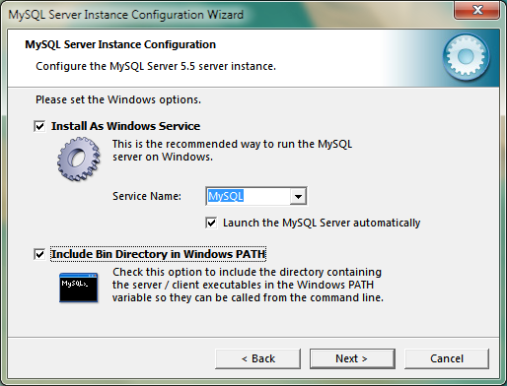
Installing MySQL
The default server port is 3306. If you change this, you'll need to specify the port in any applications that connect to the server.
Select 'Best Support for Multilingualism'. This will set the default character set to UTF-8.
Select "Include Bin Directory in Windows PATH".
Notes:
Lesson descriptions should be brief.

Slide 43
Installing MySQL
Enter a password, then finish the wizard.
The settings will be written to a file (my.ini).
If the wizard freezes for more than about 20 seconds at this point, close it and run it again... It's in bin under the directory where you installed MySQL.
Notes:
Lesson descriptions should be brief.

Slide 44
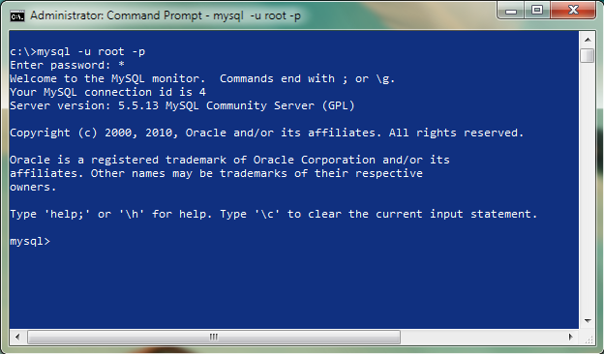
Installing MySQL
Test the installation by running the MySQL command-line client.
Notes:
Lesson descriptions should be brief.

Slide 45
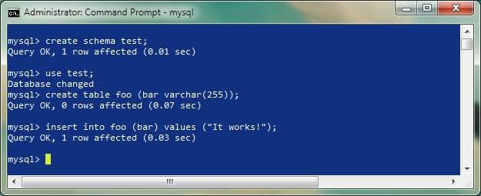
Installing MySQL
Create a database.
Notes:
Lesson descriptions should be brief.

Slide 46
Create Database
Let's first create a table in the mysql database, but before creating table, we need to create database first.
create database sonoo;
use sonoo;
create table emp(id int(10),name varchar(40),age int(3));
Notes:
Lesson descriptions should be brief.

Slide 47
Example to Connect Java Application with mysql database
import java.sql.*;
class MysqlCon{
public static void main(String args[]){
try{
Class.forName("com.mysql.jdbc.Driver");
Connection con=DriverManager.getConnection(
"jdbc:mysql://localhost:3306/sonoo","root","root");
//here sonoo is database name, root is username and password
Statement stmt=con.createStatement();
ResultSet rs=stmt.executeQuery("select * from emp");
while(rs.next())
System.out.println(rs.getInt(1)+" "+rs.getString(2)+" "+rs.getString(3));
con.close();
}catch(Exception e){ System.out.println(e);}
}
}
Notes:
Lesson descriptions should be brief.

Slide 48
MySQL Connector
To connect java application with the mysql database mysqlconnector.jar file is required to be loaded. But, first download it :
https://dev.mysql.com/downloads/connector/j/
Notes:
Lesson descriptions should be brief.

Slide 49
MySQL Connector
Two ways to load the jar file:
paste the mysqlconnector.jar file in JRE/lib/ext folder:
Download the mysqlconnector.jar file. Go to jre/lib/ext folder and paste the jar file here.
set classpath:
There are two ways to set the classpath:
temporary
permanent
Notes:
Lesson descriptions should be brief.

Slide 50
MySQL Connector
How to set the temporary classpath
open command prompt and write:
C:>set classpath=c:\folder\mysql-connector-java-5.0.8-bin.jar;.;
How to set the permanent classpath
Go to environment variable then click on new tab. In variable name write classpath and in variable value paste the path to the mysqlconnector.jar file by appending mysqlconnector.jar;.; as C:\folder\mysql-connector-java-5.0.8-bin.jar;.;
Notes:
Lesson descriptions should be brief.

Slide 51
Connect to the oracle database in java
For connecting java application with the oracle database, you need to follow steps to perform database connectivity.
In this example we are using Oracle10g as the database. So we need to know following informations for the oracle database:
Driver class: The driver class for the oracle database is oracle.jdbc.driver.OracleDriver.
Notes:
Lesson descriptions should be brief.

Slide 52
Connect to the oracle database in java
Connection URL: The connection URL for the oracle10G database is jdbc:oracle:thin:@localhost:1521:xe where jdbc is the API, oracle is the database, thin is the driver, localhost is the server name on which oracle is running, we may also use IP address, 1521 is the port number and XE is the Oracle service name. You may get all these information from the tnsnames.ora file.
Username: The default username for the oracle database is system.
Password: Password is given by the user at the time of installing the oracle database.
Notes:
Lesson descriptions should be brief.

Slide 53
Create Database
Let's first create a table in oracle database.
create table emp(id number(10),name varchar2(40),age number(3));
Notes:
Lesson descriptions should be brief.

Slide 54
Example to Connect Java Application with Oracle database
import java.sql.*;
class OracleCon{
public static void main(String args[]){
try{
//step1 load the driver class
Class.forName("oracle.jdbc.driver.OracleDriver");
//step2 create the connection object
Connection con=DriverManager.getConnection(
"jdbc:oracle:thin:@localhost:1521:xe","system","oracle");
//step3 create the statement object
Statement stmt=con.createStatement();
//step4 execute query
ResultSet rs=stmt.executeQuery("select * from emp");
while(rs.next())
System.out.println(rs.getInt(1)+" "+rs.getString(2)+" "+rs.getString(3));
//step5 close the connection object
con.close();
}catch(Exception e){ System.out.println(e);}
}
}
Notes:
Lesson descriptions should be brief.

Slide 55
Oracle Connector
To connect java application with the oracle database ojdbc14.jar file is required to be loaded. But, first download it :
https://dev.mysql.com/downloads/connector/odbc/
Notes:
Lesson descriptions should be brief.

Slide 56
Oracle Connector
Two ways to load the jar file:
paste the ojdbc14.jar file in JRE/lib/ext folder:
Download the ojdbc14.jar file. Go to jre/lib/ext folder and paste the jar file here.
set classpath:
There are two ways to set the classpath:
temporary
permanent
Notes:
Lesson descriptions should be brief.

Slide 57
Oracle Connector
How to set the temporary classpath
open command prompt and write:
C:> set classpath=c:\folder\ojdbc14.jar;.;
How to set the permanent classpath
Go to environment variable then click on new tab. In variable name write classpath and in variable value paste the path to the ojdbc14.jar file by appending ojdbc14.jar;.; as C:\oraclexe\app\oracle\product\10.2.0\server\jdbc\lib\ojdbc14.jar;.;
Notes:
Lesson descriptions should be brief.

Slide 58
Connectivity with Access without DSN
There are two ways to connect java application with the access database.
Without DSN (Data Source Name)
With DSN
Java is mostly used with Oracle, mysql, or DB2 database. So you can learn this topic only for knowledge.
Notes:
Lesson descriptions should be brief.

Slide 59
Example to Connect Java Application with access without DSN
import java.sql.*;
class Test{
public static void main(String ar[]){
try{
String database="student.mdb";//Here database exists in the current directory
String url="jdbc:odbc:Driver={Microsoft Access Driver (*.mdb)};
DBQ=" + database + ";DriverID=22;READONLY=true";
Class.forName("sun.jdbc.odbc.JdbcOdbcDriver");
Connection c=DriverManager.getConnection(url);
Statement st=c.createStatement();
ResultSet rs=st.executeQuery("select * from login");
while(rs.next()){
System.out.println(rs.getString(1));
}
}catch(Exception ee){System.out.println(ee);}
}}
Notes:
Lesson descriptions should be brief.

Slide 60
Example to Connect Java Application with access with DSN
import java.sql.*;
class Test{
public static void main(String ar[]){
try{
String url="jdbc:odbc:mydsn";
Class.forName("sun.jdbc.odbc.JdbcOdbcDriver");
Connection c=DriverManager.getConnection(url);
Statement st=c.createStatement();
ResultSet rs=st.executeQuery("select * from login");
while(rs.next()){
System.out.println(rs.getString(1));
}
}catch(Exception ee){System.out.println(ee);}
}}
Notes:
Lesson descriptions should be brief.

Slide 61
DriverManager class
The DriverManager class acts as an interface between user and drivers. It keeps track of the drivers that are available and handles establishing a connection between a database and the appropriate driver.
The DriverManager class maintains a list of Driver classes that have registered themselves by calling the method DriverManager.registerDriver()
Notes:
Lesson descriptions should be brief.

Slide 62
Commonly used methods of DriverManager class
public static void registerDriver(Driver driver):
is used to register the given driver with DriverManager.
public static void deregisterDriver(Driver driver):
is used to deregister the given driver (drop the driver from the list) with DriverManager.
public static Connection getConnection(String url):
is used to establish the connection with the specified url.
public static Connection
getConnection(String url,String userName,String password):
is used to establish the connection with the specified url, username and password.
Notes:
Lesson descriptions should be brief.

Slide 63
Connection interface
A Connection is the session between java application and database.
The Connection interface is a factory of Statement, PreparedStatement, and DatabaseMetaData i.e. object of Connection can be used to get the object of Statement and DatabaseMetaData.
The Connection interface provide many methods for transaction management like commit(), rollback() etc.
By default, connection commits the changes after executing queries.
Notes:
Lesson descriptions should be brief.

Slide 64
Commonly used methods of Connection interface
public Statement createStatement():
creates a statement object that can be used to execute SQL queries.
public Statement createStatement(int resultSetType,int resultSetConcurrency):
Creates a Statement object that will generate ResultSet objects with the given type and concurrency.
public void setAutoCommit(boolean status):
is used to set the commit status.By default it is true.
public void commit():
saves the changes made since the previous commit/rollback permanent.
public void rollback():
Drops all changes made since the previous commit/rollback.
public void close():
closes the connection and Releases a JDBC resources immediately.
Notes:
Lesson descriptions should be brief.

Slide 65
Statement interface
The Statement interface provides methods to execute queries with the database.
The statement interface is a factory of ResultSet i.e. it provides factory method to get the object of ResultSet.
Notes:
Lesson descriptions should be brief.

Slide 66
Commonly used methods of Statement interface
public ResultSet executeQuery(String sql):
is used to execute SELECT query. It returns the object of ResultSet.
public int executeUpdate(String sql):
is used to execute specified query, it may be create, drop, insert, update, delete etc.
public boolean execute(String sql):
is used to execute queries that may return multiple results.
public int[] executeBatch():
is used to execute batch of commands.
Notes:
Lesson descriptions should be brief.

Slide 67
Example of Statement interface
import java.sql.*;
class FetchRecord{
public static void main(String args[])throws Exception{
Class.forName("oracle.jdbc.driver.OracleDriver");
Connection con=
DriverManager.getConnection("jdbc:oracle:thin:@localhost:1521:xe","system","oracle");
Statement stmt=con.createStatement();
//stmt.executeUpdate("insert into emp765 values(33,'Irfan',50000)");
//int result=stmt.executeUpdate("update emp765 set name='Vimal',salary=10000 where id=33");
int result=stmt.executeUpdate("delete from emp765 where id=33");
System.out.println(result+" records affected");
con.close();
}
}
Notes:
Lesson descriptions should be brief.

Slide 68
ResultSet interface
The object of ResultSet maintains a cursor pointing to a row of a table. Initially, cursor points to before the first row.
By default, ResultSet object can be moved forward only and it is not updatable.
But we can make this object to move forward and backward direction by passing either TYPE_SCROLL_INSENSITIVE or TYPE_SCROLL_SENSITIVE in createStatement(int,int) method as well as we can make this object as updatable by:
Statement stmt = con.createStatement(ResultSet.TYPE_SCROLL_INSENSITIVE,
ResultSet.CONCUR_UPDATABLE);
Notes:
Lesson descriptions should be brief.

Slide 69
Commonly used methods of ResultSet interface
public boolean next():
is used to move the cursor to the one row next from the current position.
public boolean previous():
is used to move the cursor to the one row previous from the current position.
public boolean first():
is used to move the cursor to the first row in result set object.
public boolean last():
is used to move the cursor to the last row in result set object.
public boolean absolute(int row):
is used to move the cursor to the specified row number in the ResultSet object.
Notes:
Lesson descriptions should be brief.

Slide 70
Commonly used methods of ResultSet interface
public boolean relative(int row):
is used to move the cursor to the relative row number in the ResultSet object, it may be positive or negative.
public int getInt(int columnIndex):
is used to return the data of specified column index of the current row as int.
public int getInt(String columnName):
is used to return the data of specified column name of the current row as int.
public String getString(int columnIndex):
is used to return the data of specified column index of the current row as String.
public String getString(String columnName):
is used to return the data of specified column name of the current row as String.
Notes:
Lesson descriptions should be brief.

Slide 71
Example of Statement interface
import java.sql.*;
class FetchRecord{
public static void main(String args[])throws Exception{
Class.forName("oracle.jdbc.driver.OracleDriver");
Connection con=
DriverManager.getConnection("jdbc:oracle:thin:@localhost:1521:xe","system","oracle");
Statement stmt=con.createStatement();
//stmt.executeUpdate("insert into emp765 values(33,'Irfan',50000)");
//int result=stmt.executeUpdate("update emp765 set name='Vimal',salary=10000 where id=33");
int result=stmt.executeUpdate("delete from emp765 where id=33");
System.out.println(result+" records affected");
con.close();
}
}
Notes:
Lesson descriptions should be brief.

Slide 72
Example of Scrollable ResultSet
import java.sql.*;
class FetchRecord{
public static void main(String args[])throws Exception{
Class.forName("oracle.jdbc.driver.OracleDriver");
Connection con=DriverManager.getConnection("jdbc:oracle:thin:@localhost:1521:xe","system","oracle");
Statement stmt=con.createStatement(ResultSet.TYPE_SCROLL_SENSITIVE,ResultSet.CONCUR_UPDATABLE);
ResultSet rs=stmt.executeQuery("select * from emp765");
//getting the record of 3rd row
rs.absolute(3);
System.out.println(rs.getString(1)+" "+rs.getString(2)+" "+rs.getString(3));
con.close();
}}
Notes:
Lesson descriptions should be brief.

Slide 73
Transaction Management in JDBC
Notes:
How presentation will benefit audience: Adult learners are more interested in a subject if they know how or why it is important to them.
Presenter’s level of expertise in the subject: Briefly state your credentials in this area, or explain why participants should listen to you.

Slide 74
Transaction Management in JDBC
Transaction represents a single unit of work.
The ACID properties describes the transaction management well. ACID stands for Atomicity, Consistency, isolation and durability.
Atomicity means either all successful or none.
Consistency ensures bringing the database from one consistent state to another consistent state.
Isolation ensures that transaction is isolated from other transaction.
Durability means once a transaction has been committed, it will remain so, even in the event of errors, power loss etc.
Notes:
Lesson descriptions should be brief.

Slide 75
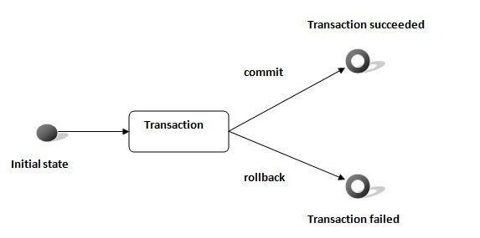
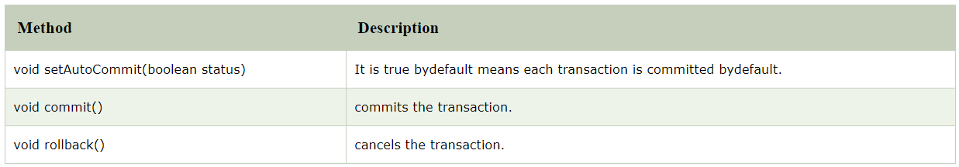
Advantage of Transaction Management
fast performance It makes the performance fast because database is hit at the time of commit.
In JDBC, Connection interface provides methods to manage transaction.
Notes:
Lesson descriptions should be brief.

Slide 76
Simple example of transaction management in jdbc using Statement
import java.sql.*;
class FetchRecords{
public static void main(String args[])throws Exception{
Class.forName(“mysql.jdbc.driver.OracleDriver");
Connection con=DriverManager.getConnection("jdbc:mysql:thin:@localhost:1521:xe","system","oracle");
con.setAutoCommit(false);
Statement stmt=con.createStatement();
stmt.executeUpdate("insert into user420 values(190,'abhi',40000)");
stmt.executeUpdate("insert into user420 values(191,'umesh',50000)");
con.commit();
con.close();
}}
Notes:
Lesson descriptions should be brief.

Slide 77
Example of transaction management in jdbc using PreparedStatement
import java.sql.*;
import java.io.*;
class TM{
public static void main(String args[]){
try{
Class.forName("oracle.jdbc.driver.OracleDriver");
Connection con=DriverManager.getConnection("jdbc:oracle:thin:@localhost:1521:xe","system","oracle");
con.setAutoCommit(false);
PreparedStatement ps=con.prepareStatement("insert into user420 values(?,?,?)");
BufferedReader br=new BufferedReader(new InputStreamReader(System.in));
while(true){
System.out.println("enter id");
String s1=br.readLine();
int id=Integer.parseInt(s1);
Notes:
Lesson descriptions should be brief.

Slide 78
Example of transaction management in jdbc using PreparedStatement
System.out.println("enter name");
String name=br.readLine();
System.out.println("enter salary");
String s3=br.readLine();
int salary=Integer.parseInt(s3);
ps.setInt(1,id);
ps.setString(2,name);
ps.setInt(3,salary);
ps.executeUpdate();
System.out.println("commit/rollback");
String answer=br.readLine();
if(answer.equals("commit")){
con.commit();
}
if(answer.equals("rollback")){
con.rollback();
}
Notes:
Lesson descriptions should be brief.

Slide 79
Example of transaction management in jdbc using PreparedStatement
System.out.println("Want to add more records y/n");
String ans=br.readLine();
if(ans.equals("n")){
break;
}
}
con.commit();
System.out.println("record successfully saved");
con.close();//before closing connection commit() is called
}catch(Exception e){System.out.println(e);}
}}
Notes:
Lesson descriptions should be brief.

Slide 80


